Slide 1
ALiBaVa Preliminary Non-Irradiated ATLAS12Measurements
Cameron Simpson-Allsop (with thanks to Elliot Reynolds)

Slide 2
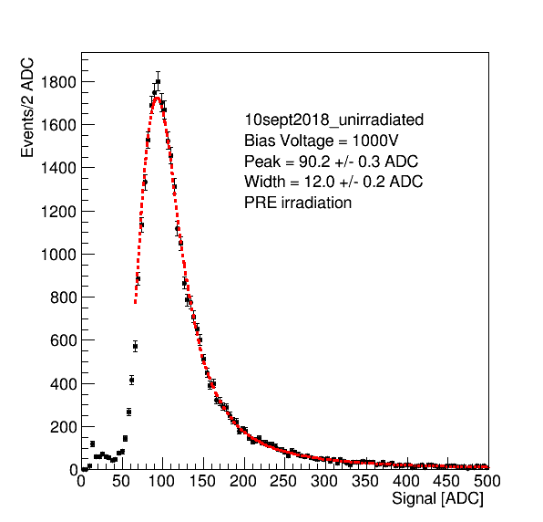
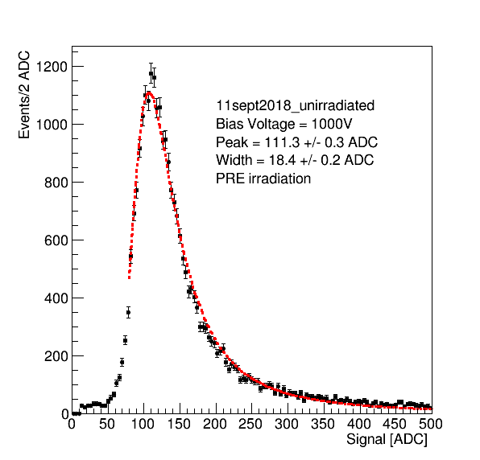
Example Distributions
Warm Run
Cold Run

Slide 3
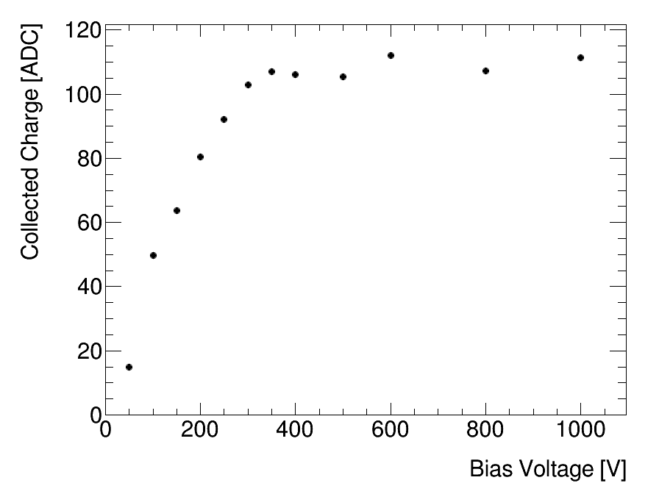
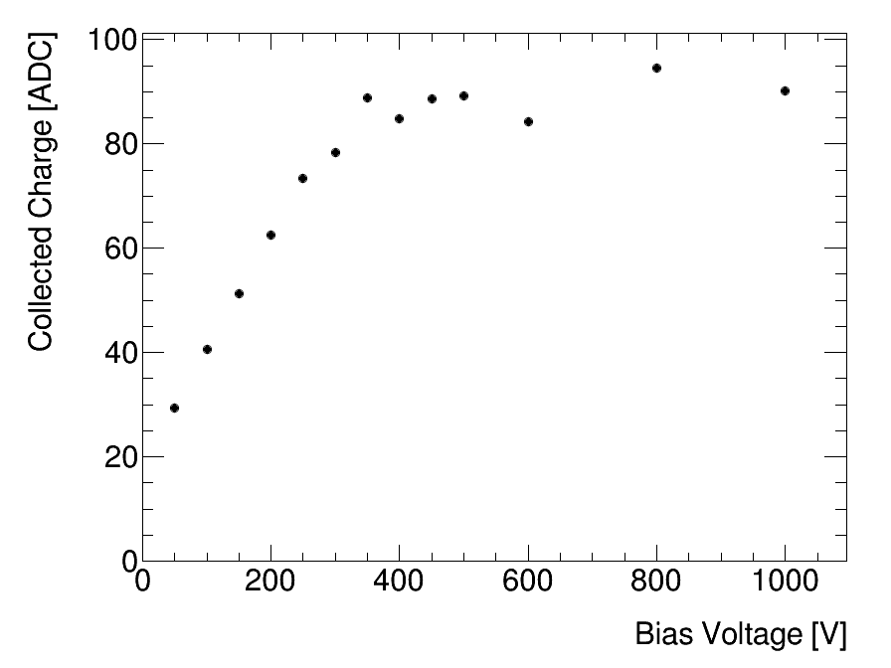
Cold Run
Collected Charge vs Voltage
Warm Run

Slide 4
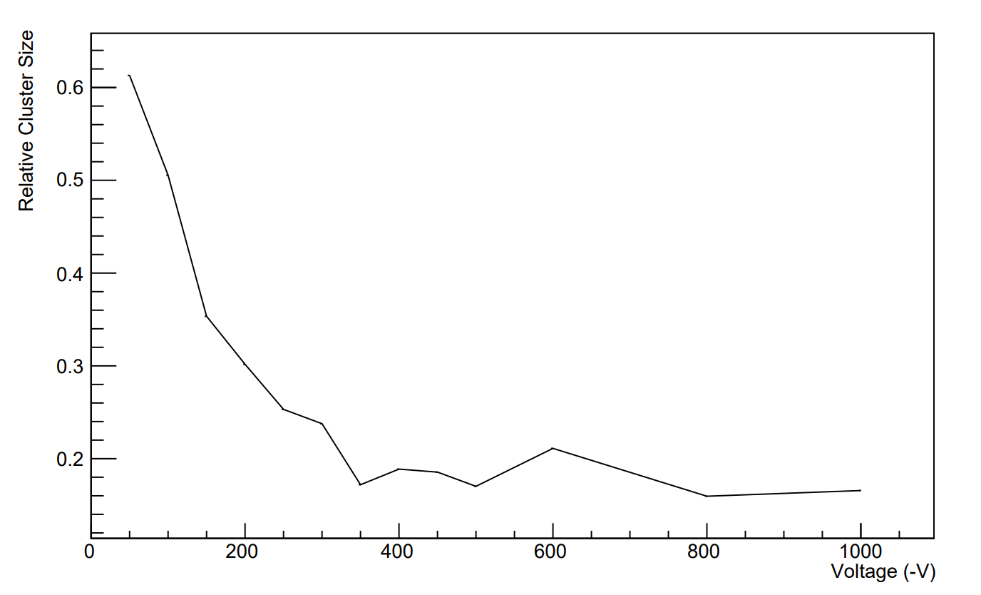
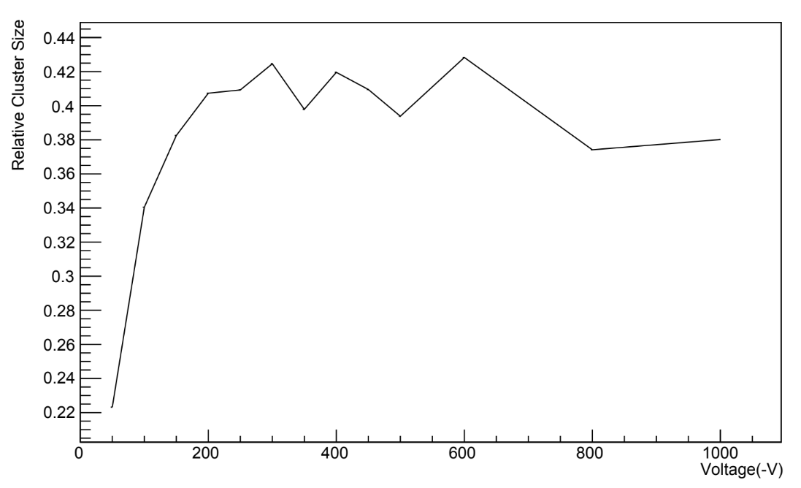
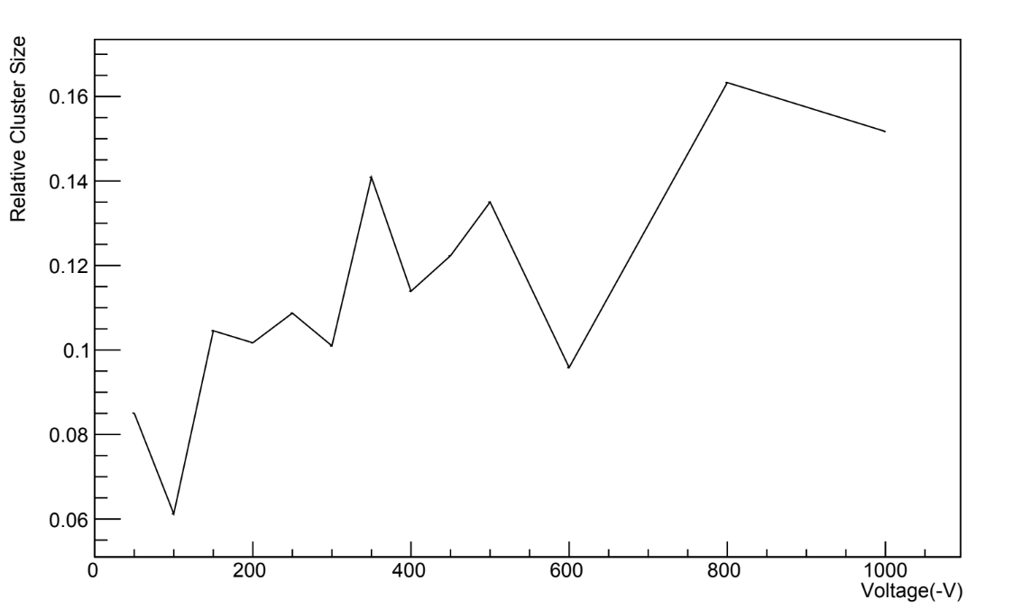
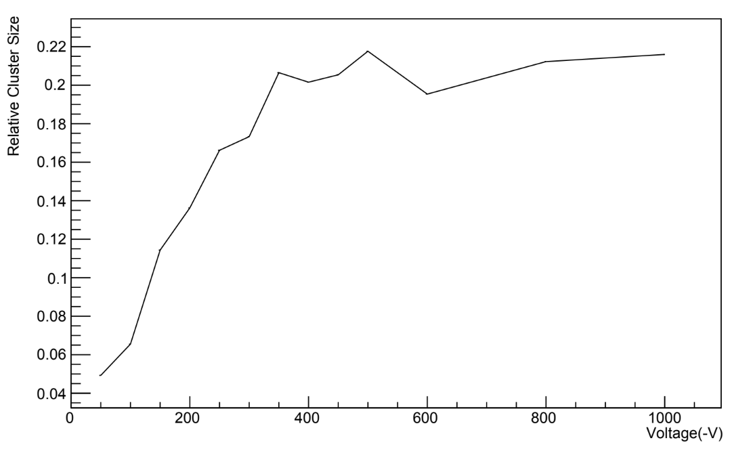

Warm Set Cluster Size
One Hit
Two Hits
Three Hits
Four Hits
Four or More Hits

Slide 5
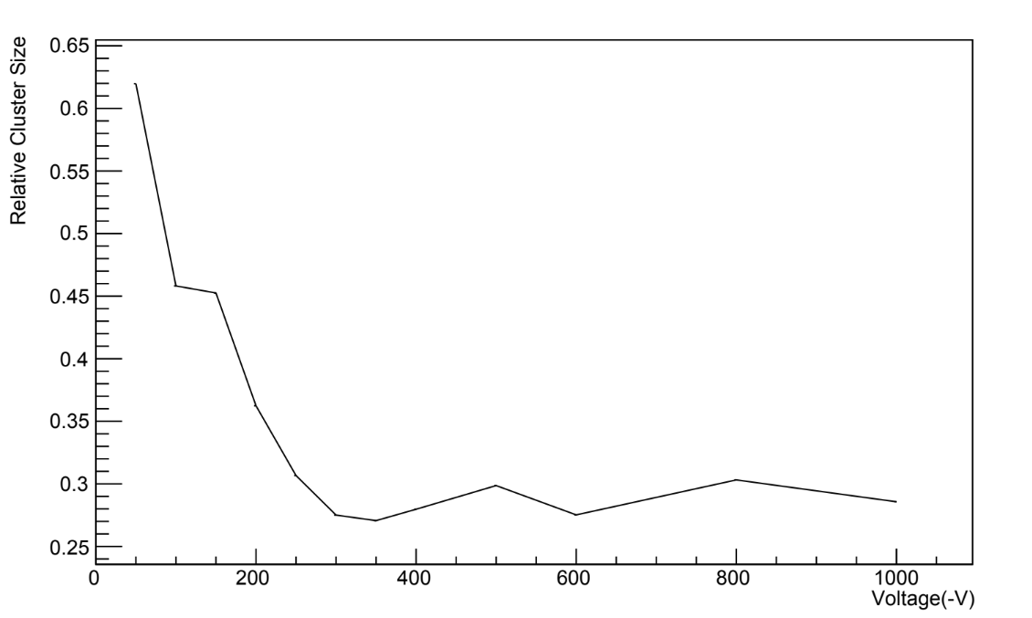
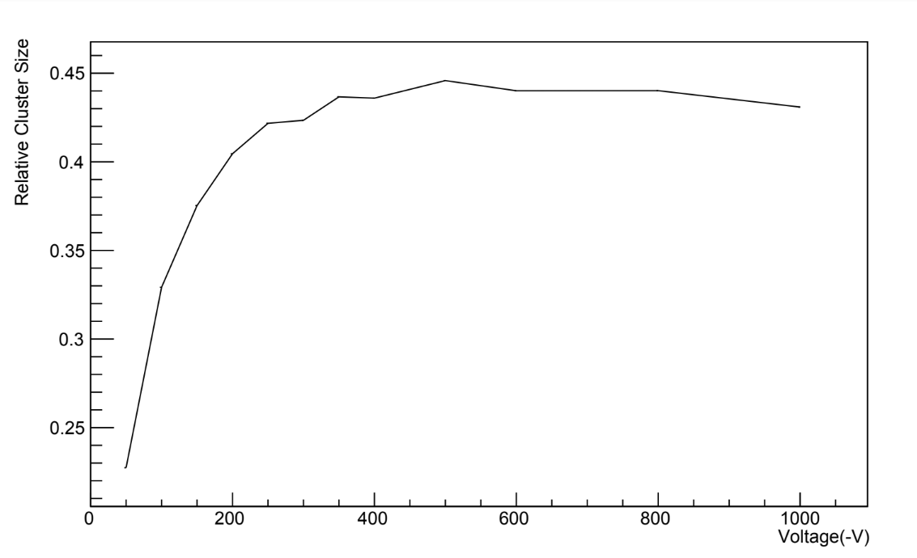
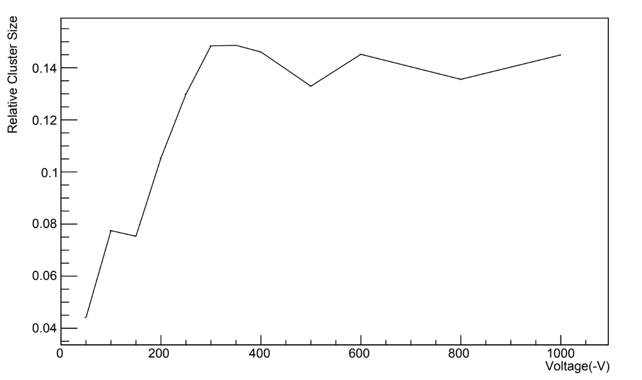
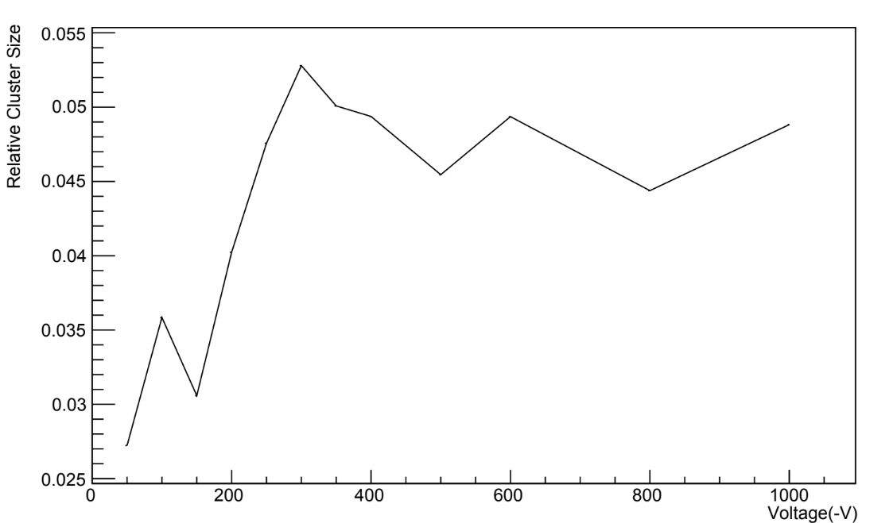
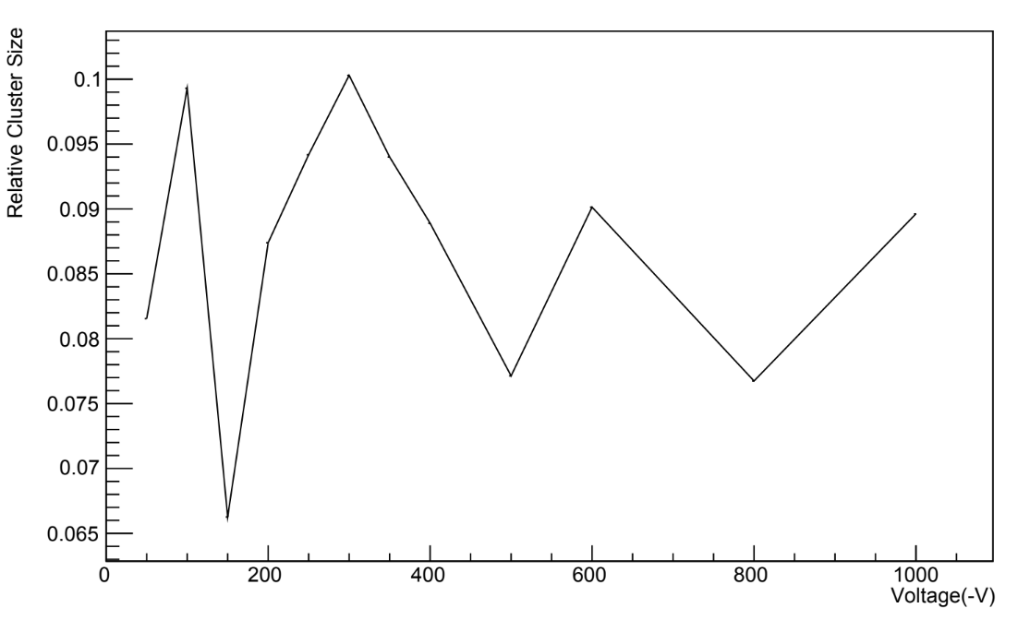
Cold Set Cluster Size
One Hit
Two Hits
Three Hits
Four Hits
Four or More Hits

